Slide 1
Breaking the Body of Christ ?
2022
César García

Slide 2
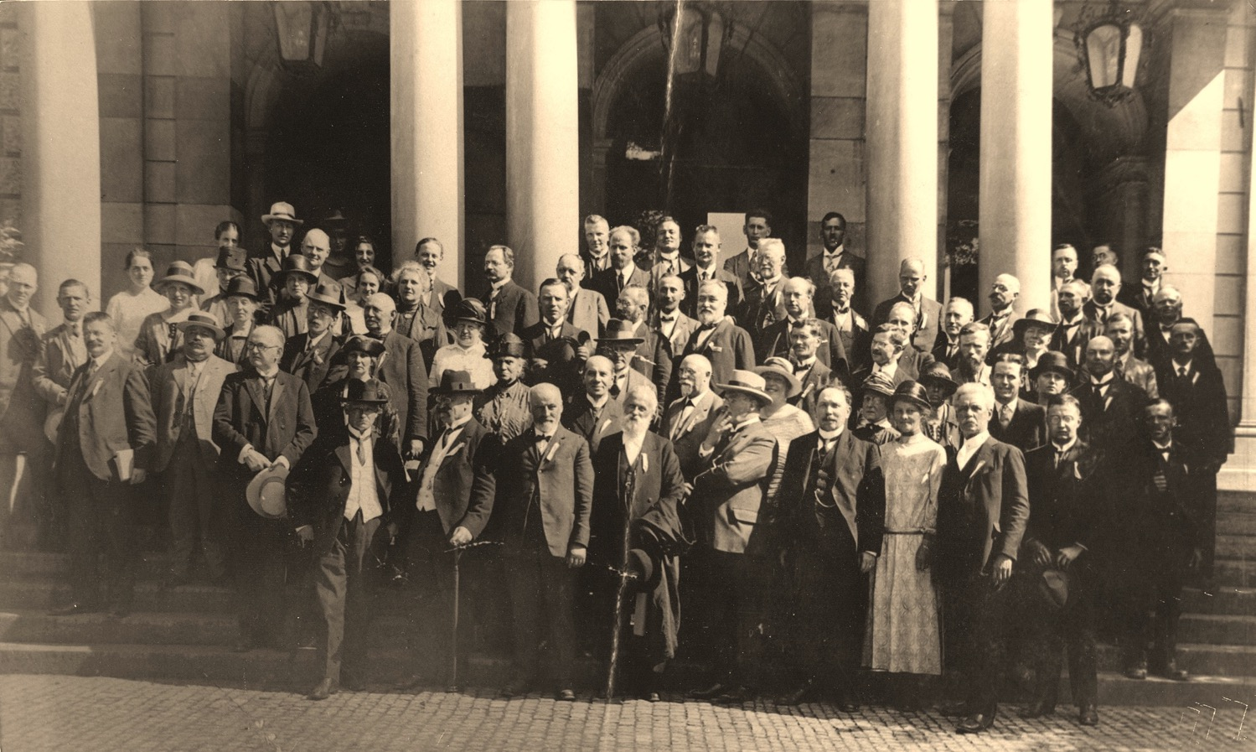
First Global Assembly
1925 Switzerland
César García

Slide 3
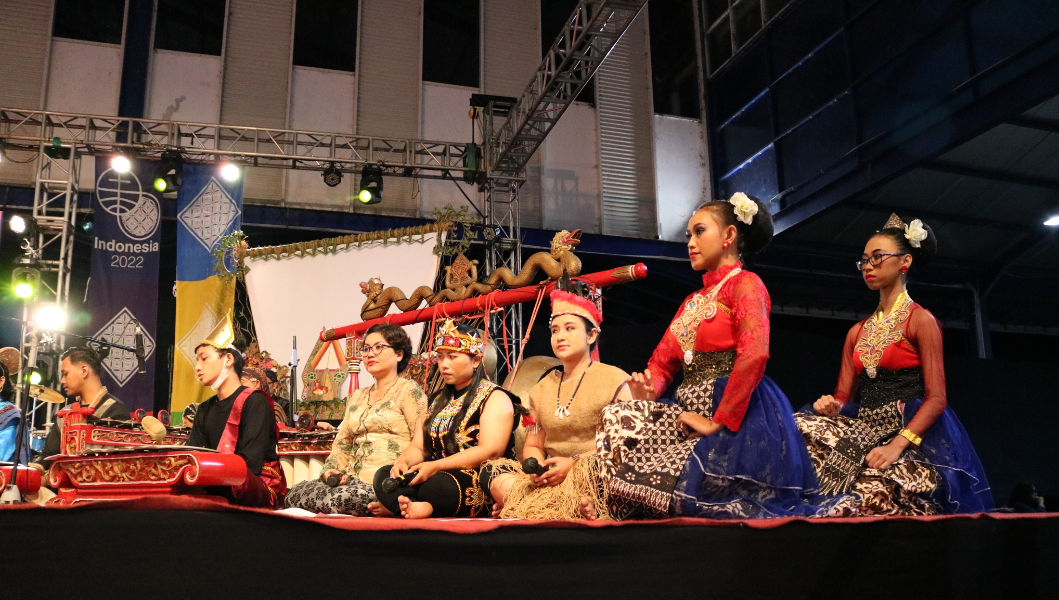
Seventeenth Global Assembly
2022 Indonesia
César García
Notes:
Cosas que han y no han cambiado

Slide 4
“¹⁸So that, with the eyes of your heart enlightened,
you may know
what is the hope to which he has called you,
what are the riches of his glorious inheritance
among the saints,
¹⁹and what is the immeasurable greatness
of his power for us who believe,
according to the working of his great power.”
Eph 1:18-19 (NRSV)
César García
Notes:
A call (Invitation)
Is revealed and given by God
It is communal
Has to do with God’s Power & inheritance, love, call, Spirit (words mentioned in 1:9-11 and 4)

Slide 5

Our Hope
Is an Invitation
Is God’s gift
Is communal
César García

Slide 6
“⁹ He has made known to us
the mystery of his will,
according to his good pleasure that he set forth
in Christ,
¹⁰ as a plan for the fullness of time,
to gather up all things in him,
things in heaven and things on earth.”
Eph 1:9-10 (NRSV)
César García
Notes:
Movement toward unity in Christ.

Slide 7
“¹⁴ For he is our peace;
in his flesh he has made both groups into one
and has broken down the dividing wall,
that is, the hostility between us...
that he might create in himself one new humanity
in place of the two, thus making peace,
¹⁶ and might reconcile both groups to God in one body
through the cross,
thus putting to death that hostility through it.”
Eph 2:14-16 (NRSV)
César García
Notes:
Movement toward unity in Christ.

Slide 8
“…until all of us
come to the unity of the faith and
of the knowledge of the Son of God,
to maturity,
to the measure
of the full stature of Christ .”
Eph 4:13 (NRSV)
César García

Slide 9
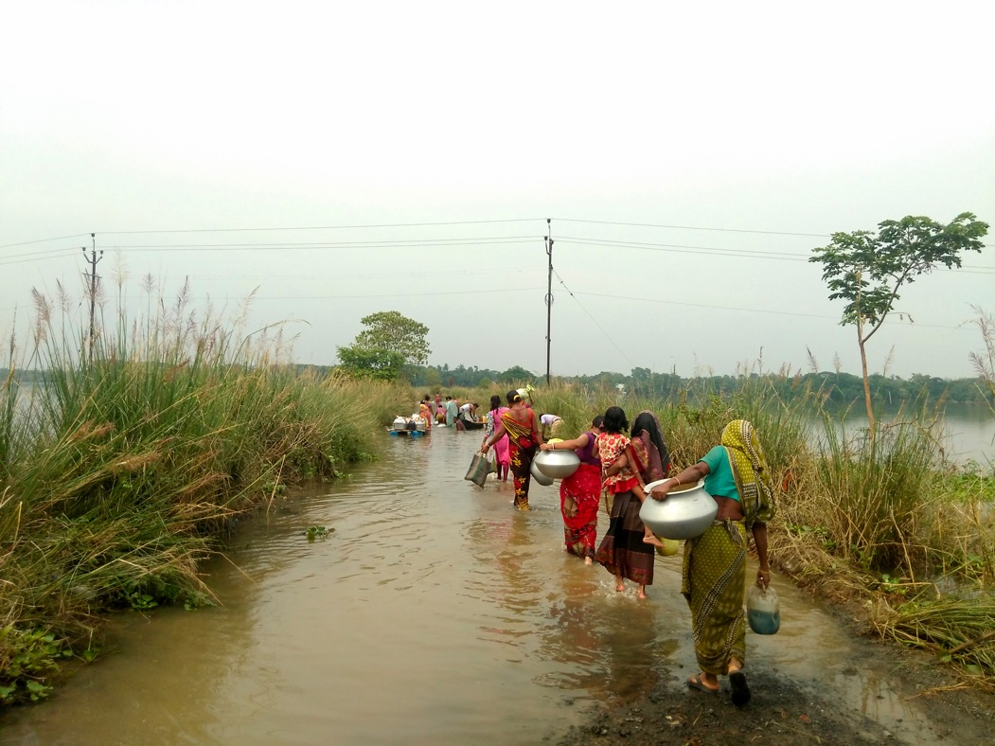
César García
MCC photo

Slide 10
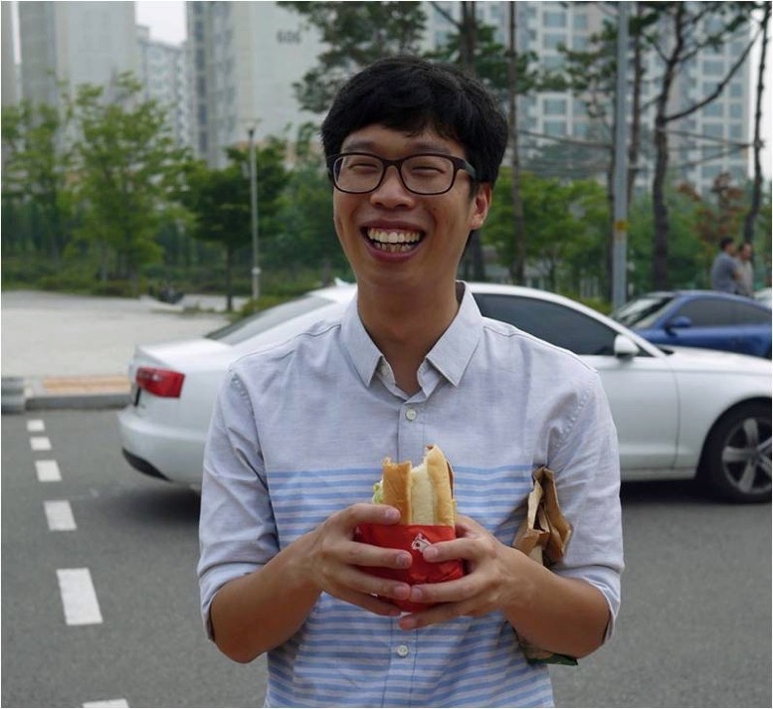
César García
Sangmin Lee
Notes:
Sangmin Lee

Slide 11





César García

Slide 12
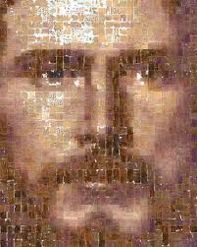
César García

